Slide 1
Test your IQ
Jeji Vedullapalli Venkatesh Javvaji

Slide 2
Contents
Introduction
Sample Code
Demo

Slide 3
Introduction
An intelligent quotient (IQ) is a score derived from one of the several standardized tests
Designed to assess human intelligence
Median raw score is generally 100
Approximately two-thirds of population score between 85 and 115
Five percent of population scores above 125

Slide 4
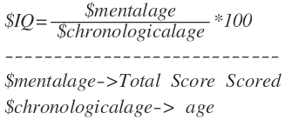
Formula

Slide 5
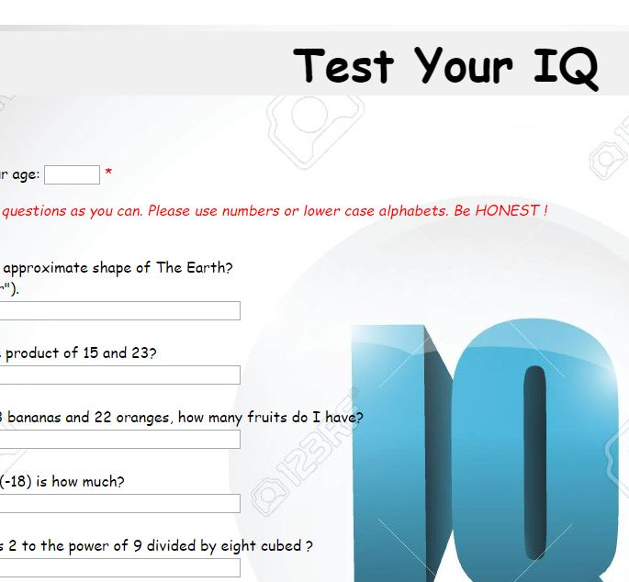
Sample Code
<link rel="stylesheet" type="text/css" href="IQstyle.css" title="style" />
</HEAD>
<body>
<form action="IQ.php" method="post">
<p><span class="error">* required field.</span></p>
Please enter your age: <input type="text" name="age" size="4">
<span class="error">* </span>

Slide 6
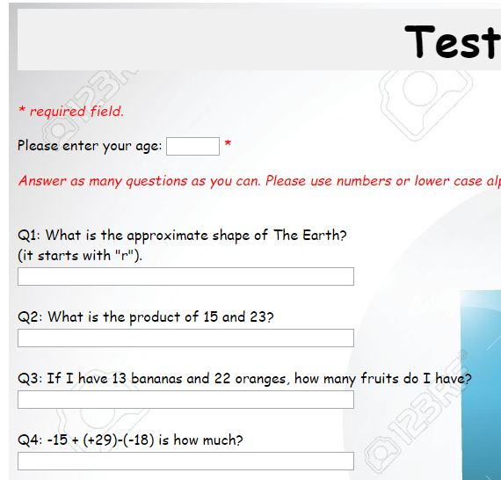
Sample Code
html
{
height: 100%;
background-image:url(iqtest.jpg);
background-attachment: fixed;
padding:50px;
}
body{
color:#000;
font-family:Comic Sans MS;
font-size:16px;
padding:10px;
background-image:url(IQ1.jpg);
background-image opacity:0.5;
font-weight:1000;
}

Slide 7
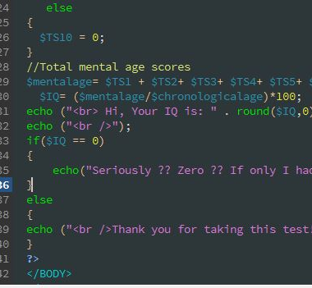
Sample Code
$T1 = $_POST["T1"];
$T2 = $_POST["T2"];
$T3 = $_POST["T3"];
$T4 = $_POST["T4"];
$T5 = $_POST["T5"];
$T6 = $_POST["T6"];
$T7 = $_POST["T7"];
$T8 = $_POST["T8"];
$T9 = $_POST["T9"];
$T10 = $_POST["T10"];
$age = $_POST["age"];

Slide 8

Demo

Slide 9


